Slide 1





Larana Software House
Page 1
Page 2
Page 3
Page 4
Page 5
Page 6
Page 7
Page 8
Page 9
Page 10
1
2
3
4
5
6
7
8
9
10
11
12
13
14
15
16
17
18
19
20
21
WEB ETP SESSION 5
Presented By
1.Krsihna Revanwar
2.Siddhant Belkhede
3.Pravin Jadhav
Programmer Presentation
Copyright Larana
2025

Slide 2
Larana Software House
Page 1
Page 2
Page 3
Page 4
Page 5
Page 6
Page 7
Page 8
Page 9
Page 10
1
2
3
4
5
6
7
8
9
10
11
12
13
14
15
16
17
18
19
20
21
INTRODUCTION AND CORE IDEA
1. What is a Single Page Application (SPA)?
A Single Page Application (SPA) is a type of web application where the entire app runs inside a single HTML page.
Instead of loading new HTML files from the server for every page (like old websites do), SPAs dynamically update the content on the page using JavaScript.
This makes the app feel fast and smooth because only the required data or component changes, not the whole page.
EXAMPLES
Sites that use SPA:- Gmail,Netflix
Non-SPA Sites:-
Wikipedia,IRCTC
Programmer Presentation
Copyright Larana
2025

Slide 3
Larana Software House
Page 1
Page 2
Page 3
Page 4
Page 5
Page 6
Page 7
Page 8
Page 9
Page 10
1
2
3
4
5
6
7
8
9
10
11
12
13
14
15
16
17
18
19
20
21
2.The Problem (How to create different URLs?)
If everything is inside one page, you face a challenge:
How do you show different views (like Home, About, Contact) with different URLs (/home, /about, /contact)?
In a traditional website, the server handles this (each URL maps to a different file).
But in a SPA, there’s only one HTML file. So by default, everything just stays on the same URL (usually /).
Programmer Presentation
Copyright Larana
2025

Slide 4
Larana Software House
Page 1
Page 2
Page 3
Page 4
Page 5
Page 6
Page 7
Page 8
Page 9
Page 10
1
2
3
4
5
6
7
8
9
10
11
12
13
14
15
16
17
18
19
20
21
3.The Solution : React Router
React Router is the official library for handling routing in React apps.
It lets you map different URLs (/, /about, /contact, /products/5) to different React components.
This means:
You can type a URL and land directly on that page (deep linking).
Browser back/forward buttons will work normally.
You can bookmark/share links and they’ll open the right page.
You keep the SPA speed (no full page reloads).
t
Programmer Presentation
Copyright Larana
2025

Slide 5
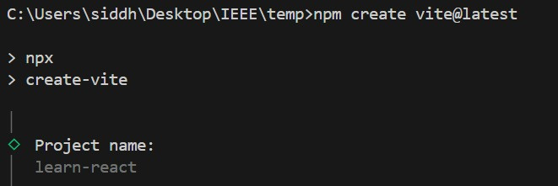
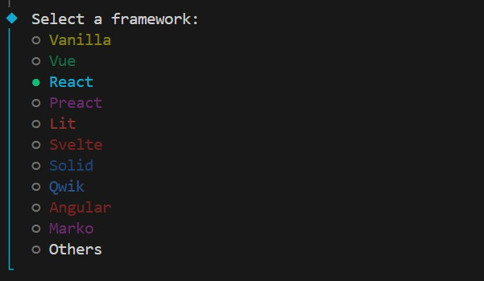
Larana Software House
Page 1
Page 2
Page 3
Page 4
Page 5
Page 6
Page 7
Page 8
Page 9
Page 10
1
2
3
4
5
6
7
8
9
10
11
12
13
14
15
16
17
18
19
20
21
Installation
1.First run (npm create vite@latest)
2.Select React
Programmer Presentation
Copyright Larana
2025

Slide 6
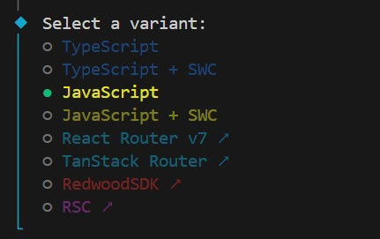
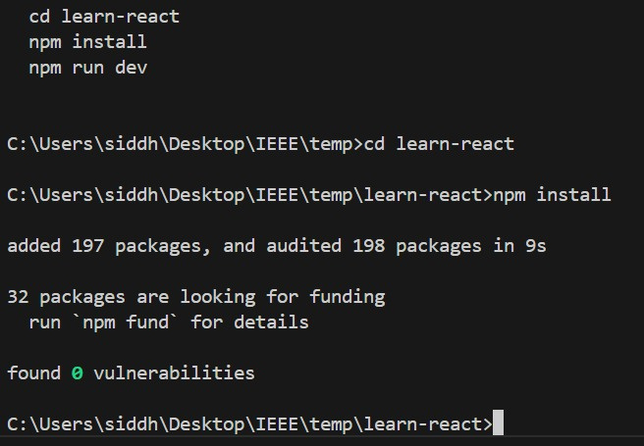
Larana Software House
Page 1
Page 2
Page 3
Page 4
Page 5
Page 6
Page 7
Page 8
Page 9
Page 10
1
2
3
4
5
6
7
8
9
10
11
12
13
14
15
16
17
18
19
20
21
Installation
3.Select javascript
4.navigate to new created folder by cd <floderName>
and install dependences by running npm install
Programmer Presentation
Copyright Larana
2025

Slide 7
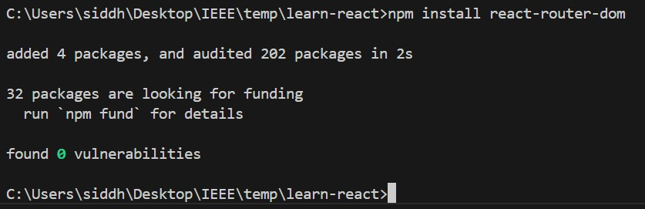
Larana Software House
Page 1
Page 2
Page 3
Page 4
Page 5
Page 6
Page 7
Page 8
Page 9
Page 10
1
2
3
4
5
6
7
8
9
10
11
12
13
14
15
16
17
18
19
20
21
Installation
5.install react router dom with npm install react-router-dom
Programmer Presentation
Copyright Larana
2025

Slide 8
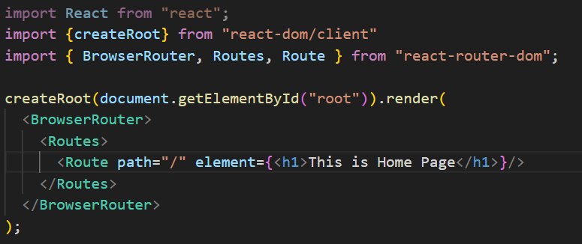
Larana Software House
Page 1
Page 2
Page 3
Page 4
Page 5
Page 6
Page 7
Page 8
Page 9
Page 10
1
2
3
4
5
6
7
8
9
10
11
12
13
14
15
16
17
18
19
20
21
The Core Components of React Router
BrowserRouter
A wrapper component from React Router.
Uses the browser's history API to keep your UI in sync with the URL.
You put it at the root of your app to enable routing.
<Routes>
It A container for all your <Route> components.
It matches the current URL with the best matching <Route>.
Only renders the first matching <Route>
<Route>
In short
Defines a mapping between a URL path and the component to render.
Example: <route path="/about" element={<About />} /> will render <About /> when the user visits /about.
<BrowserRouter>: Router system
<Routes>: List of possible routes
<Route>: One specific rile for rendering.
Programmer Presentation
Copyright Larana
2025

Slide 9
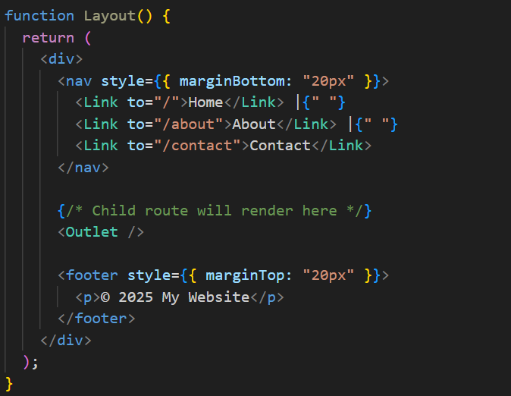
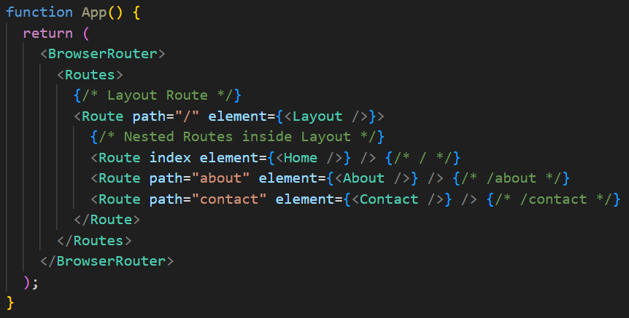
Larana Software House
Page 1
Page 2
Page 3
Page 4
Page 5
Page 6
Page 7
Page 8
Page 9
Page 10
1
2
3
4
5
6
7
8
9
10
11
12
13
14
15
16
17
18
19
20
21
Nested routes & Shared Layouts
Layout Route
<Outlet>
A Layout Route is a parent <Route> that containd shared UI (like aa navbar, sidebar, or footer).
It wraps child routes so you don't repeat the same layout code everywhere.
<Outlet> is a placeholder inside a Layout Route.
It tells React Router where the matched child route's components ahould be renderes.
Programmer Presentation
Copyright Larana
2025

Slide 10

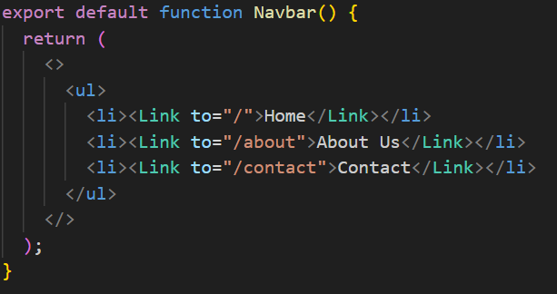
Larana Software House
Page 1
Page 2
Page 3
Page 4
Page 5
Page 6
Page 7
Page 8
Page 9
Page 10
1
2
3
4
5
6
7
8
9
10
11
12
13
14
15
16
17
18
19
20
21
Navigation with <Link>
<Link>
<NavLink>
<Link> is React Router's replacement for <a>.
Changes the URL without reloading the page.
Just like <Link>, but smarter.
Good when highlighting the active link.
Programmer Presentation
Copyright Larana
2025

Slide 11
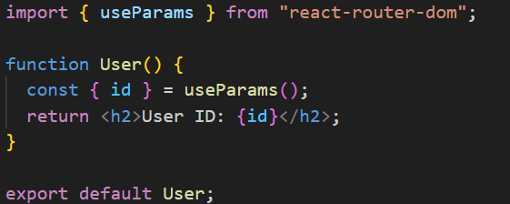
Larana Software House
Page 1
Page 2
Page 3
Page 4
Page 5
Page 6
Page 7
Page 8
Page 9
Page 10
1
2
3
4
5
6
7
8
9
10
11
12
13
14
15
16
17
18
19
20
21
Dynamic Routing
useParams()
A dynamic route lets you pass variable parts in the URL.
We define it with : before the parameter name.
usePaeams() us a React Router hook.
it returns an object wit all URL params.
useSearchParams()
A dynamic route lets you pass variable parts in the URL.
A hook from React Router for working with query string parameters (the path after ? in the URL).
Programmer Presentation
Copyright Larana
2025

Slide 12

Larana Software House
Page 1
Page 2
Page 3
Page 4
Page 5
Page 6
Page 7
Page 8
Page 9
Page 10
1
2
3
4
5
6
7
8
9
10
11
12
13
14
15
16
17
18
19
20
21
What is API?
API = Application Programming Interface.
Acts as a bridge between client (browser/app) and server.
Allows different software systems to communicate.
Provides rules for how requests and responses are made.
APIs often return data in JSON format.
Example:
Food delivery app calls an API to get restaurant menus.
Programmer Presentation
Copyright Larana
2025

Slide 13
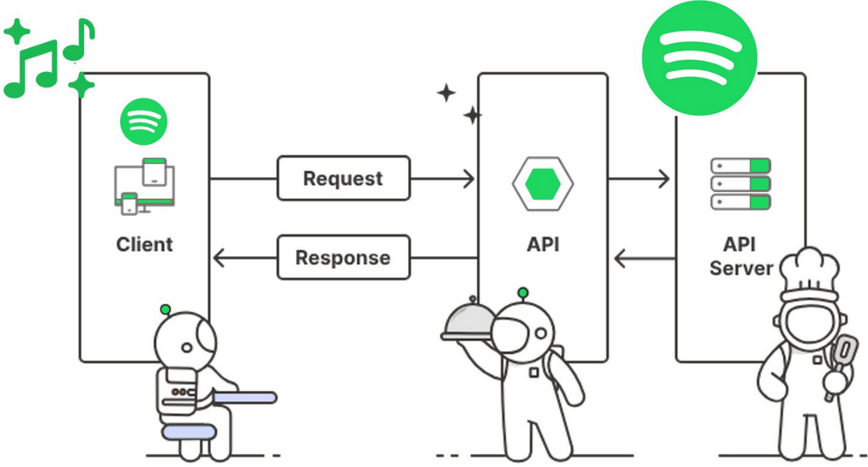
Larana Software House
Page 1
Page 2
Page 3
Page 4
Page 5
Page 6
Page 7
Page 8
Page 9
Page 10
1
2
3
4
5
6
7
8
9
10
11
12
13
14
15
16
17
18
19
20
21
How does API work?
Client sends a request to an API endpoint (URL).
Server processes the request and sends a response.
Uses HTTP protocol (GET, POST, PUT, DELETE).
Response often contains data + status code.
Programmer Presentation
Copyright Larana
2025

Slide 14

Larana Software House
Page 1
Page 2
Page 3
Page 4
Page 5
Page 6
Page 7
Page 8
Page 9
Page 10
1
2
3
4
5
6
7
8
9
10
11
12
13
14
15
16
17
18
19
20
21
What is JSON File.
JSON (JavaScript Object Notation)
🔹 What is JSON?
A lightweight format for storing and exchanging data.
Human-readable text, based on key-value pairs.
Commonly used in APIs to send data between client and server.
🔹 Why JSON is Important?
Easy to read and write.
Language-independent (used in almost all programming languages).
Works seamlessly with JavaScript and React.
Programmer Presentation
Copyright Larana
2025

Slide 15

Larana Software House
Page 1
Page 2
Page 3
Page 4
Page 5
Page 6
Page 7
Page 8
Page 9
Page 10
1
2
3
4
5
6
7
8
9
10
11
12
13
14
15
16
17
18
19
20
21
Types of API Requests
APIs use HTTP Methods to define the action.
Four most common requests:
GET – Retrieve data
POST – Send new data
PUT – Update existing data
DELETE – Remove data
Programmer Presentation
Copyright Larana
2025

Slide 16
Larana Software House
Page 1
Page 2
Page 3
Page 4
Page 5
Page 6
Page 7
Page 8
Page 9
Page 10
1
2
3
4
5
6
7
8
9
10
11
12
13
14
15
16
17
18
19
20
21
GET Request
Used to fetch data from server.
Does not modify data.
Most common type of request.Safe: does not change server data.
Can be cached by browser.
Example use case: Search for users, fetch songs.
Programmer Presentation
Copyright Larana
2025

Slide 17

Larana Software House
Page 1
Page 2
Page 3
Page 4
Page 5
Page 6
Page 7
Page 8
Page 9
Page 10
1
2
3
4
5
6
7
8
9
10
11
12
13
14
15
16
17
18
19
20
21
POST Request
Used to send new data to server.
Commonly used in forms, user signup, etc
Creates new data on server.
Not idempotent → multiple POSTs = multiple new entries.
Example: Register a new account, add a new comment.
Programmer Presentation
Copyright Larana
2025

Slide 18

Larana Software House
Page 1
Page 2
Page 3
Page 4
Page 5
Page 6
Page 7
Page 8
Page 9
Page 10
1
2
3
4
5
6
7
8
9
10
11
12
13
14
15
16
17
18
19
20
21
PUT Request
Used to update existing data on server.
Must specify the resource (usually by ID).
Idempotent → sending the same request multiple times has same effect.
Example: Update profile picture, edit blog title.
Programmer Presentation
Copyright Larana
2025

Slide 19
Larana Software House
Page 1
Page 2
Page 3
Page 4
Page 5
Page 6
Page 7
Page 8
Page 9
Page 10
1
2
3
4
5
6
7
8
9
10
11
12
13
14
15
16
17
18
19
20
21
DELETE Request
Used to remove data from server.
Requires resource ID.
Idempotent → deleting again has no effect.
Example: Remove a post, delete a product from DB.
Programmer Presentation
Copyright Larana
2025

Slide 20
Larana Software House
Page 1
Page 2
Page 3
Page 4
Page 5
Page 6
Page 7
Page 8
Page 9
Page 10
1
2
3
4
5
6
7
8
9
10
11
12
13
14
15
16
17
18
19
20
21
JavaScript Fetch API
What is Fetch API?
A built-in JavaScript function used to make HTTP requests (no need to install anything).
Works in modern browsers.
Returns a Promise (so you can use .then() or async/await).
🔹 Key Features:
Default method is GET (but you can use POST, PUT, DELETE, etc.).
Responses need to be parsed (usually with .json() for JSON data).
Supports headers, body, and custom options.
Can be canceled using AbortController.
Programmer Presentation
Copyright Larana
2025

Slide 21
Larana Software House
Page 1
Page 2
Page 3
Page 4
Page 5
Page 6
Page 7
Page 8
Page 9
Page 10
1
2
3
4
5
6
7
8
9
10
11
12
13
14
15
16
17
18
19
20
21
Axios Library
🔹 What is Axios?
A popular JavaScript library for making HTTP requests.
Works in both browser and Node.js.
Built on top of Promises, with a simpler syntax than fetch().
🔹 Key Features:
Auto JSON parsing → response data is available directly in res.data.
Shorter & cleaner syntax compared to fetch.
Supports all HTTP methods: GET, POST, PUT, DELETE.
Has built-in timeout & cancellation support.
Allows interceptors (middleware for requests/responses).
Works consistently across browsers (better error handling than fetch).
Programmer Presentation
Copyright Larana
2025

Slide 22
Larana Software House
Page 1
Page 2
Page 3
Page 4
Page 5
Page 6
Page 7
Page 8
Page 9
Page 10
1
2
3
4
5
6
7
8
9
10
11
12
13
14
15
16
17
18
19
20
21
Larana Software House
Thank You
Yes
No
Programmer Presentation
Copyright Larana
2025

